Slide 1

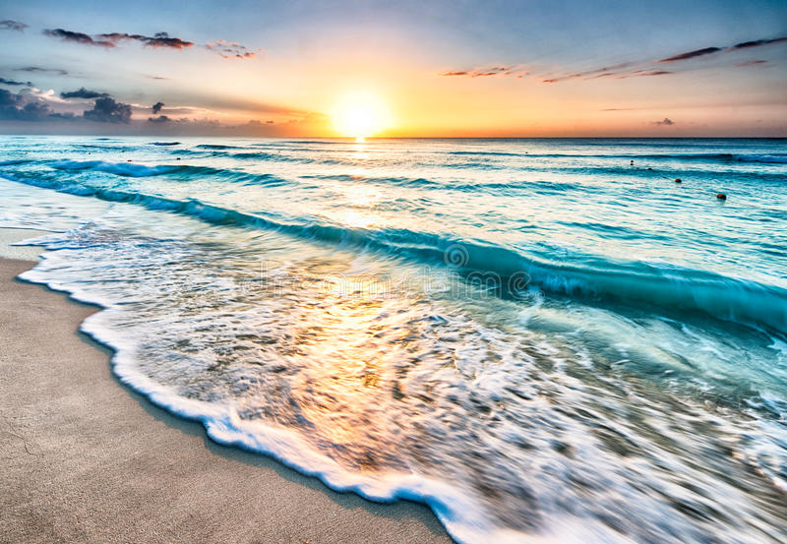
Smart Beach by Bruce County
for Dr. Alex Smith
Sanjeev Kumar - Professor
Brunilda Xhaferllari – Project Manager
Rich Freeman – Faculty Mentor
AI Team:
Janvi Patel
Fangji Chen
Scaria Ouseph Kurian
Date: 02-09-2023
Notes:
Image: 12019 (2016) Ocean waves crashing on shore during daytime https://pixabay.com/photos/beach-sea-sunset-sun-sunlight-1751455/

Slide 2

Additional activities since the last report
Work:
Reverse Engineering for getting better accuracy.
Implemented Crowd counting models for beach_use and station_beach data.
Labelled images for accuracy matrix.
Crowd counting models
: InsightFace
: ResNet
: YOLOv8
We have accuracy for all models of all images.
Notes:
Padrinan, Miguel (n.d.). Email blocks on Gray Surface. Accessed on January 16th, 2023 from https://www.pexels.com/photo/email-blocks-on-gray-surface-1591062/

Slide 3
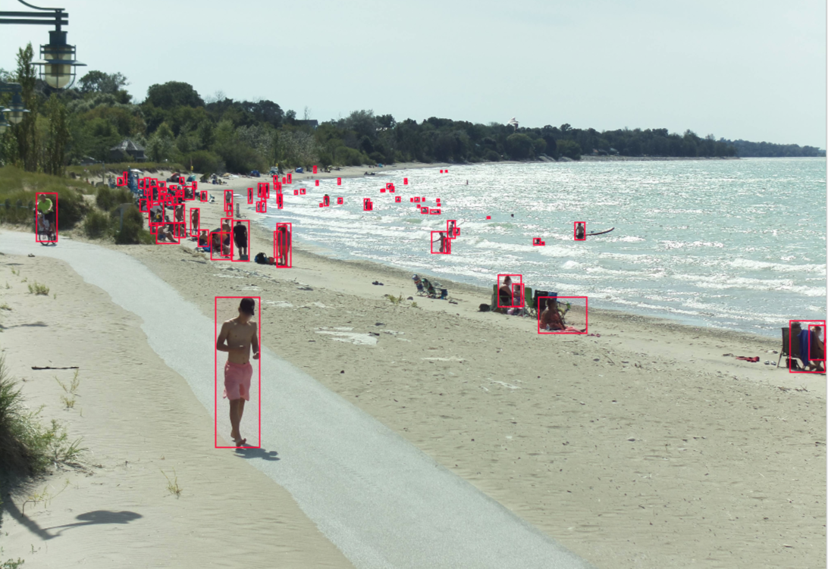
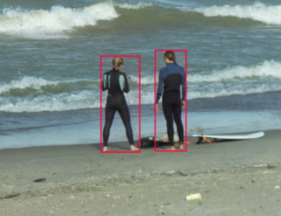
As we can see in the image we have labeled all the images first.
By which we had ground truth of all images.
After which we implemented the accuracy matrix.
Results showed which model works best for the particular image.
Based on this we can decide on classes for the training classification model.

Slide 4
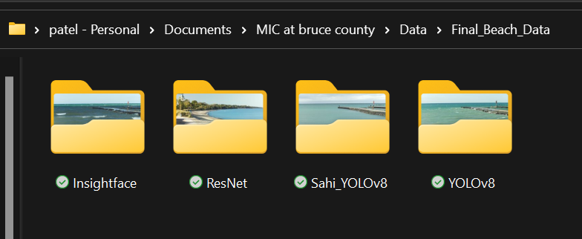
Final Data Folder Structure

Slide 5
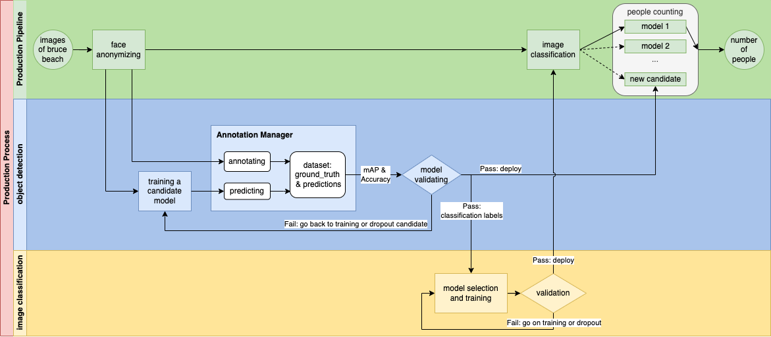

Slide 6
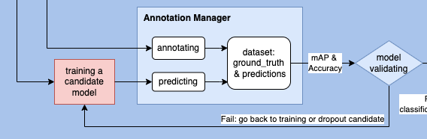
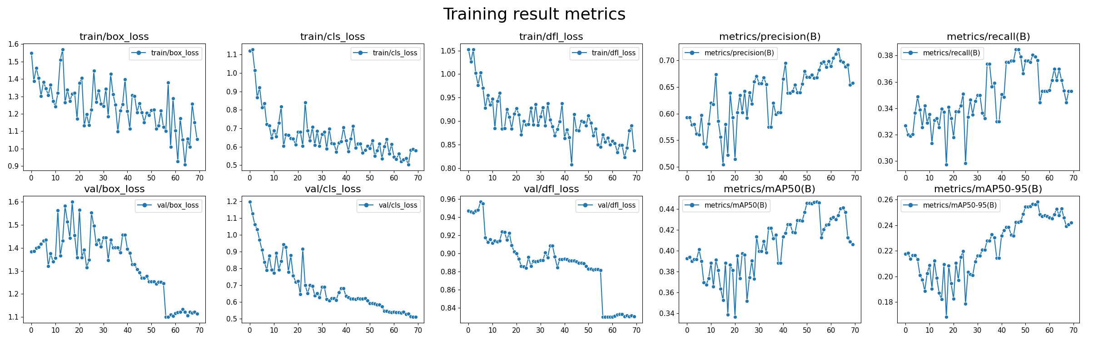
Individual Status Report- Fangji

Slide 7

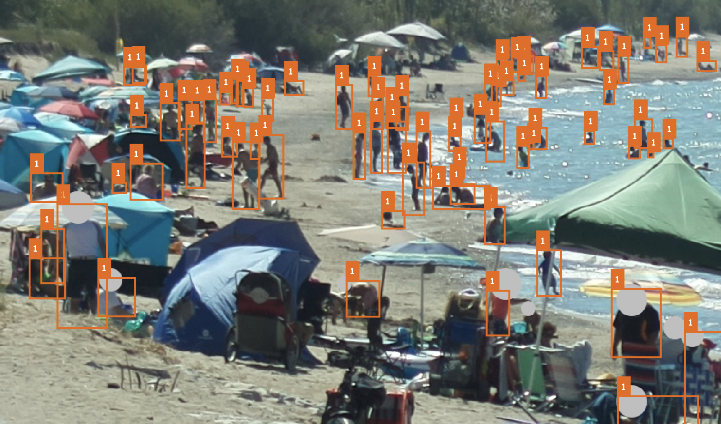
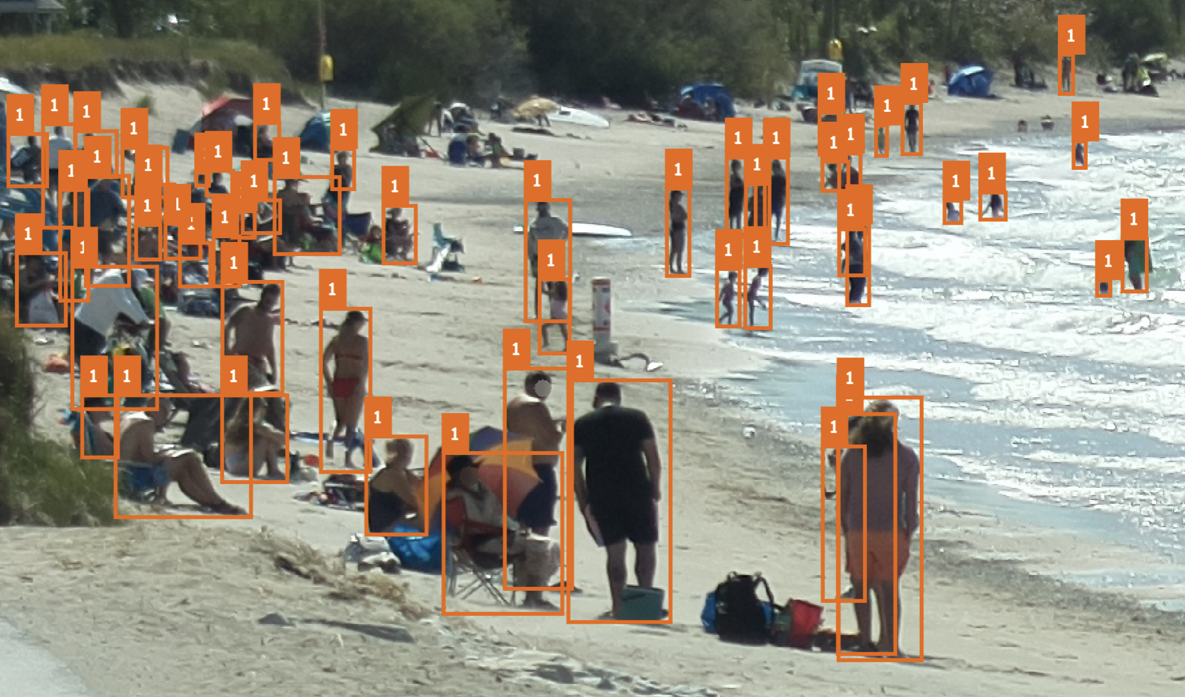
Individual Status Report- Fangji
Picture3.png
2022-09-02_13-50-14.png

Slide 8
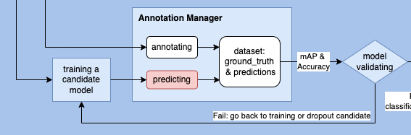
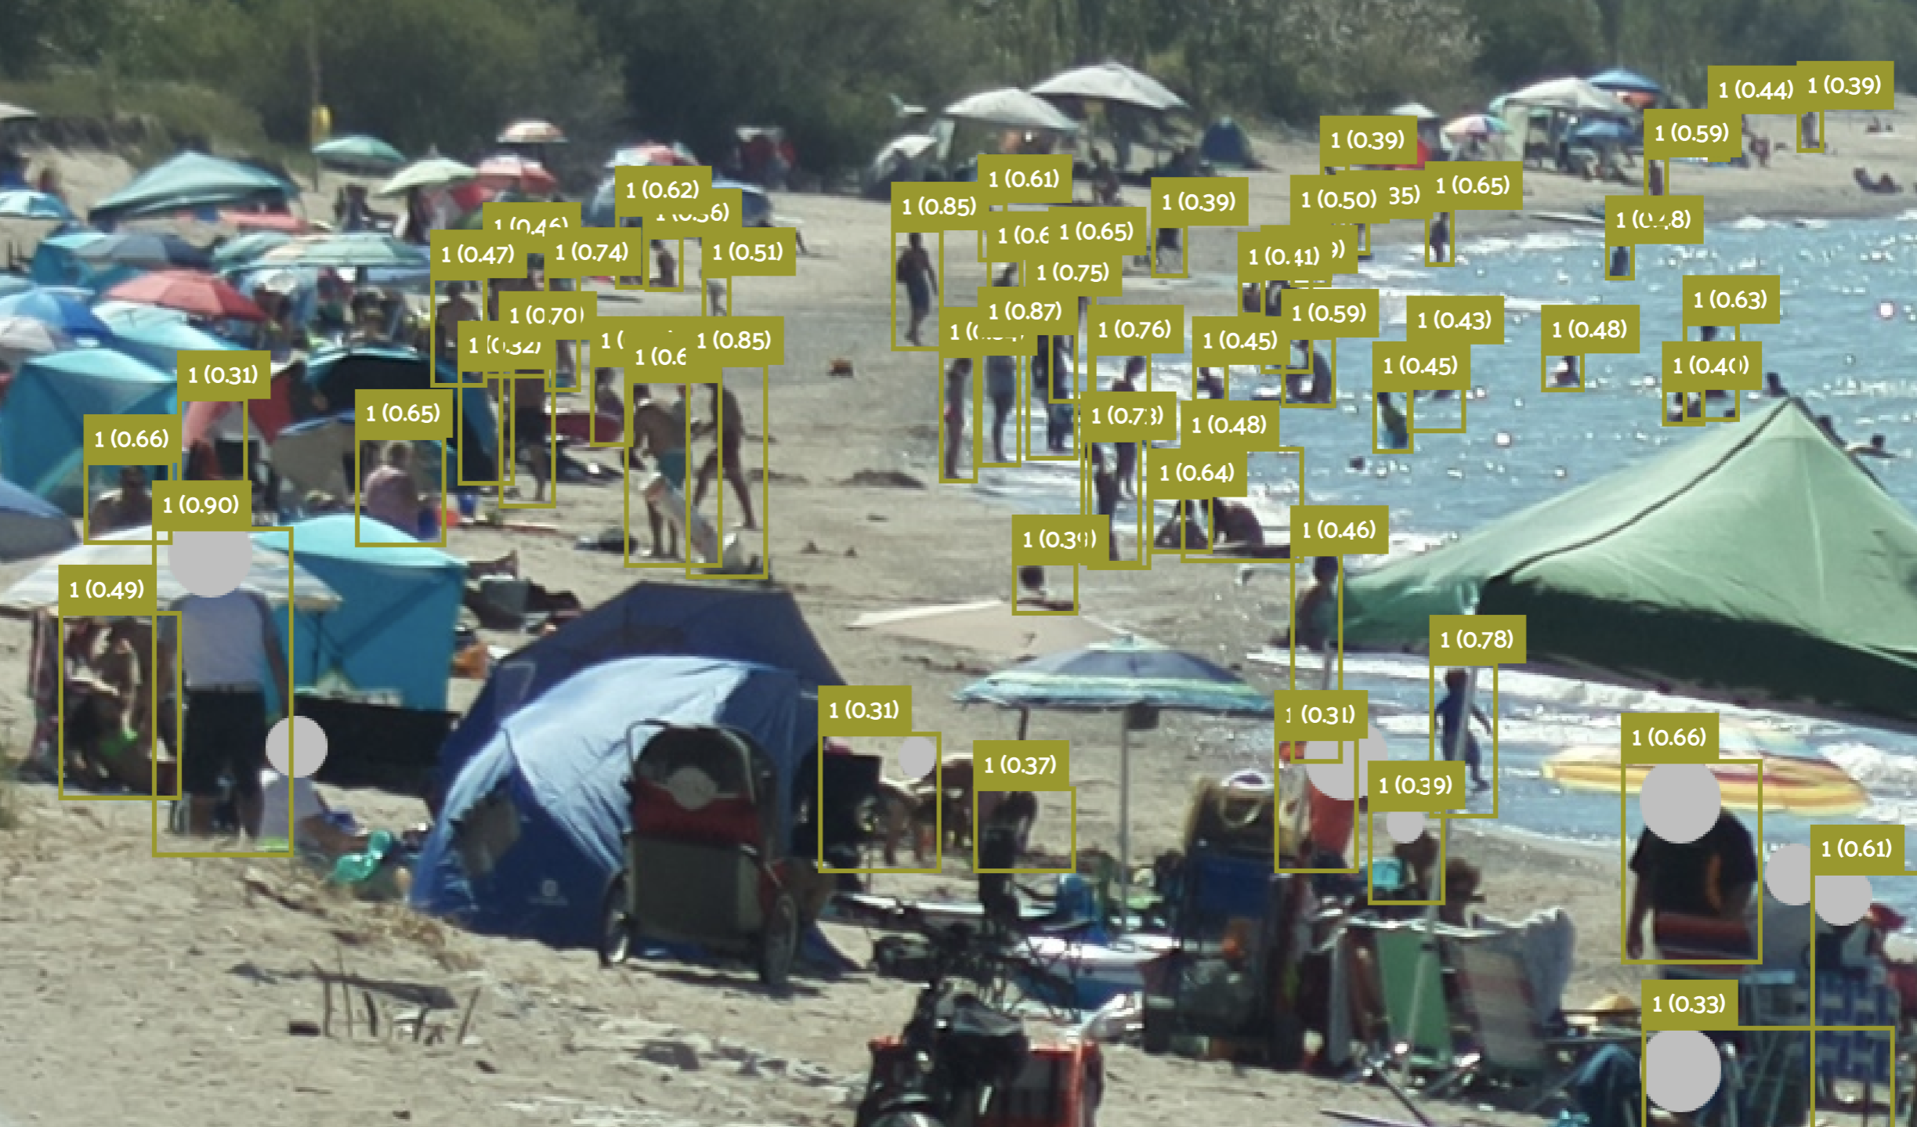
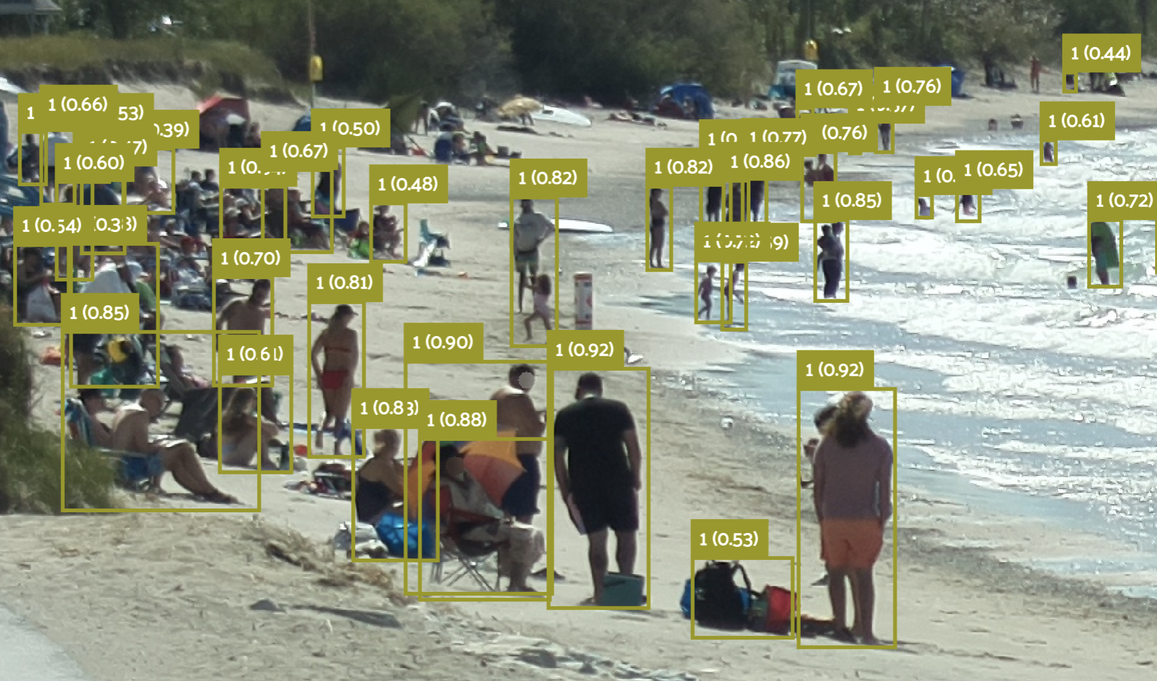
Individual Status Report- Fangji
Picture3.png
2022-09-02_13-50-14.png

Slide 9
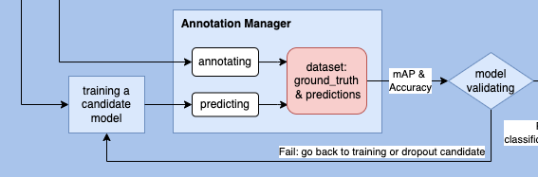
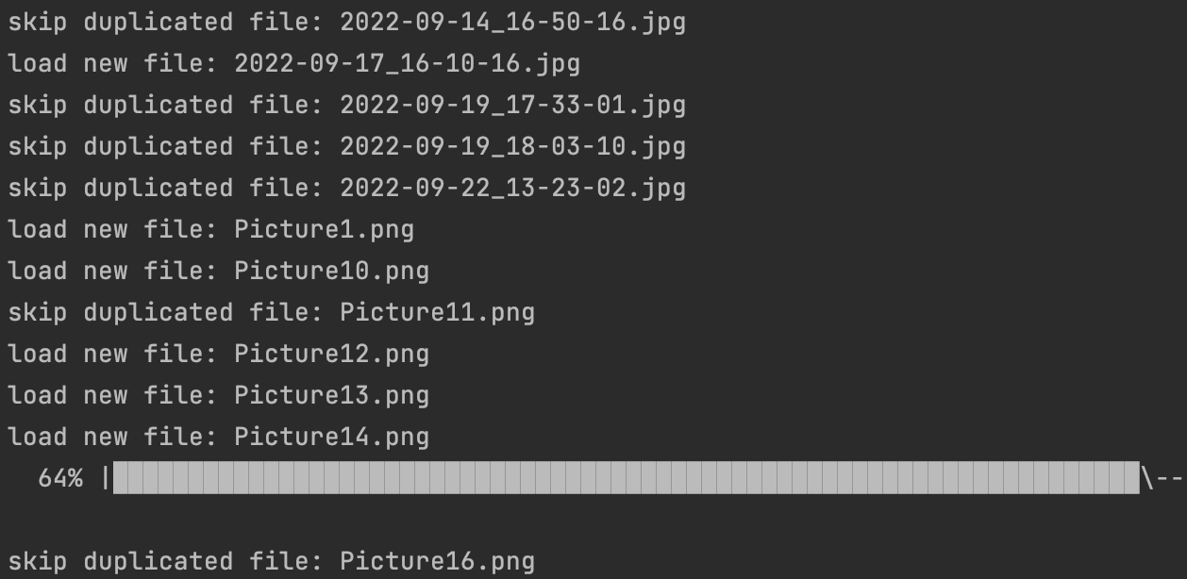
Individual Status Report- Fangji
Incrementally update the ground_truth & predictions of new images

Slide 10
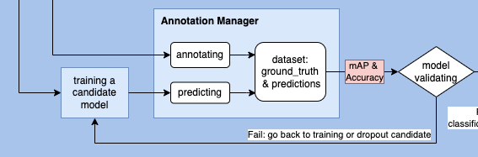
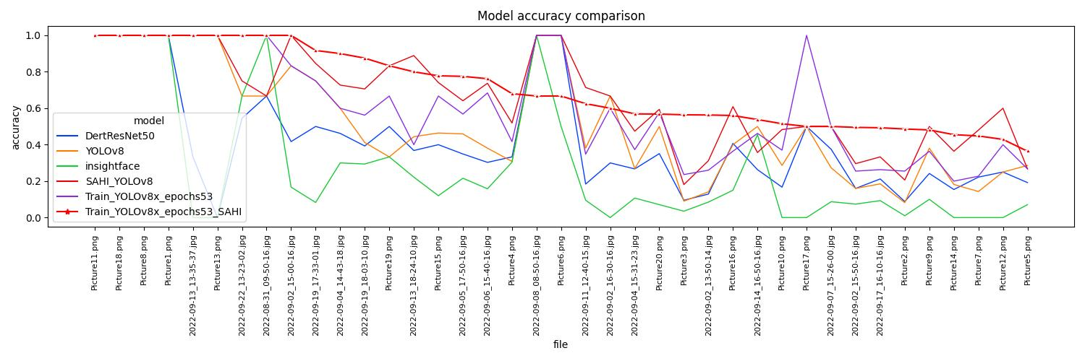
Individual Status Report- Fangji

Slide 11
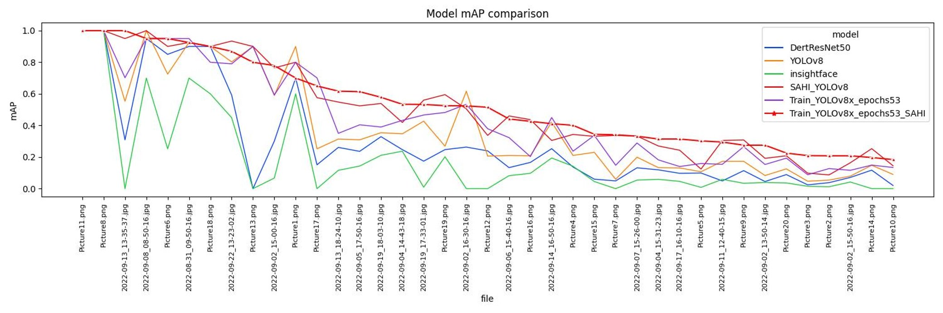
Individual Status Report- Fangji

Slide 12

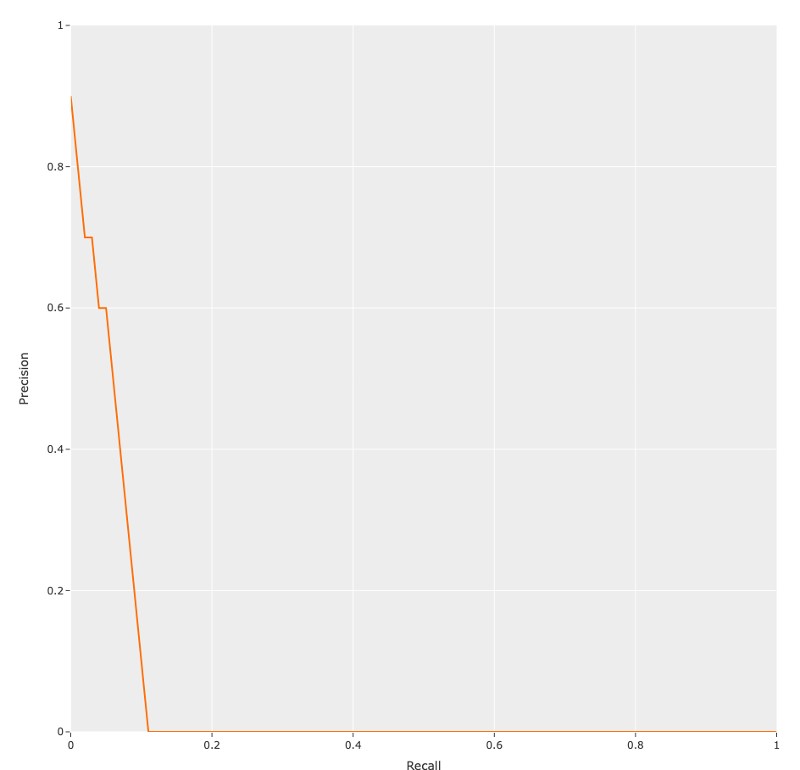
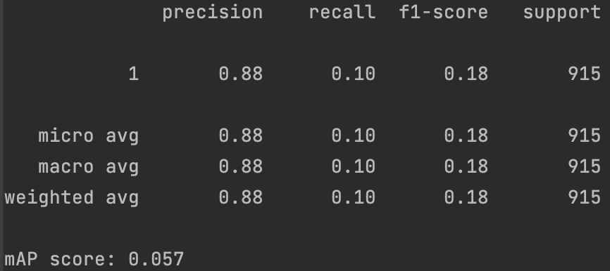
Individual Status Report- Fangji
InsightFace

Slide 13
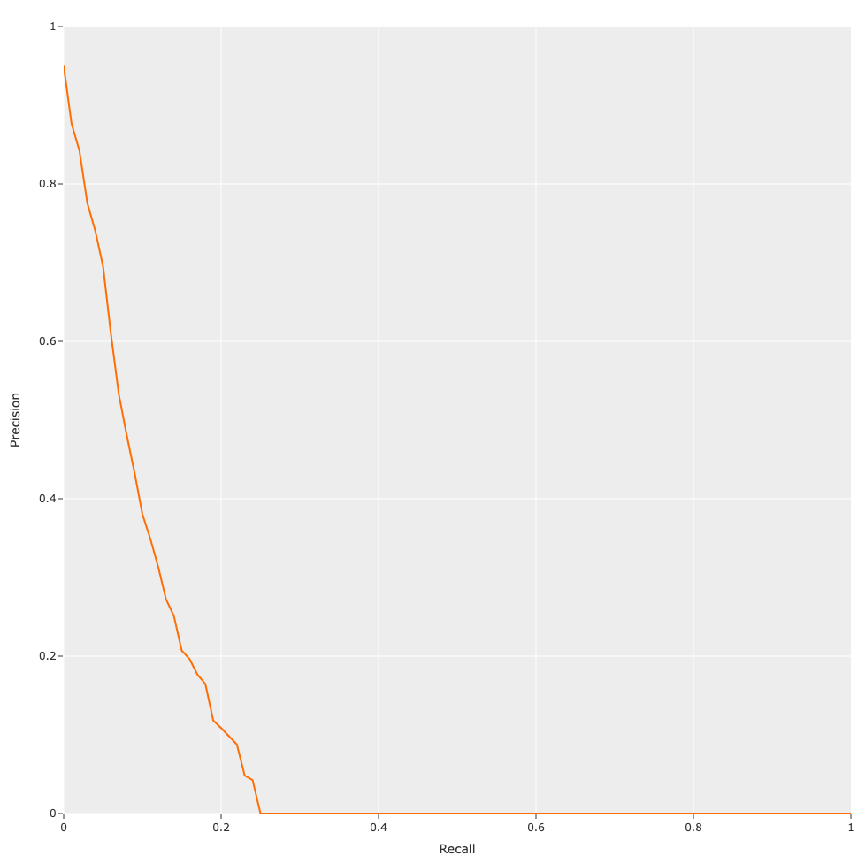
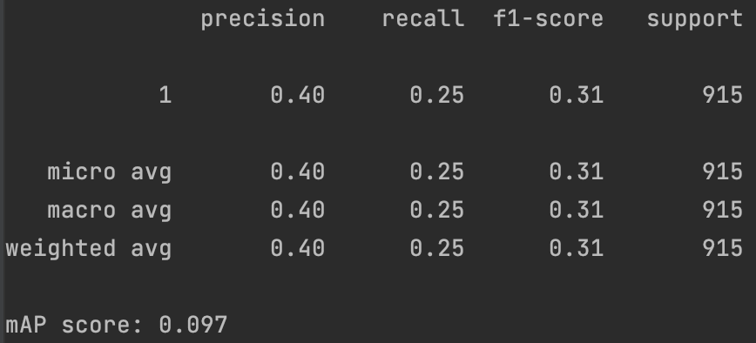
Individual Status Report- Fangji
DertResNet50

Slide 14
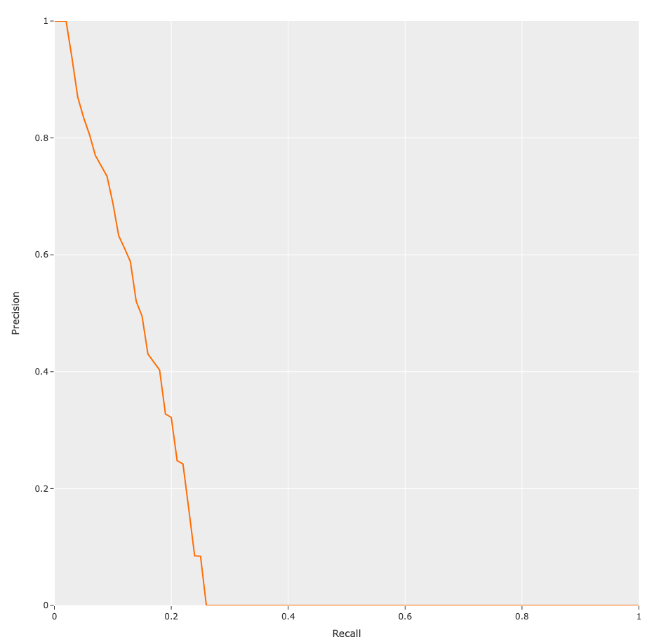

Individual Status Report- Fangji
YOLOv8

Slide 15
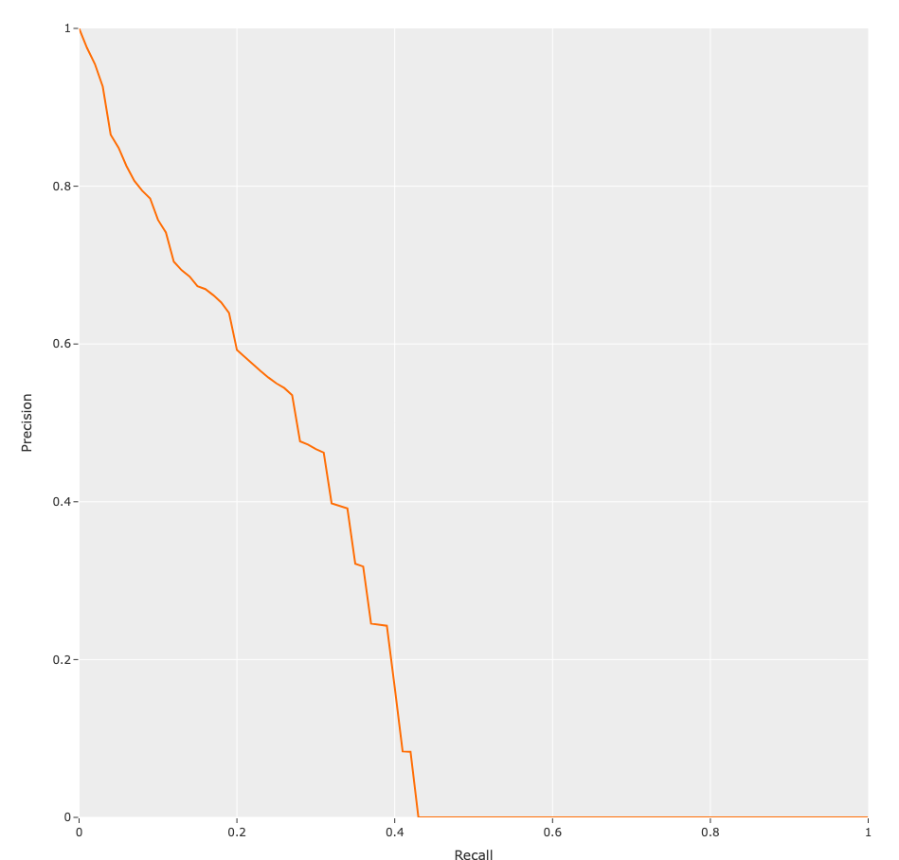
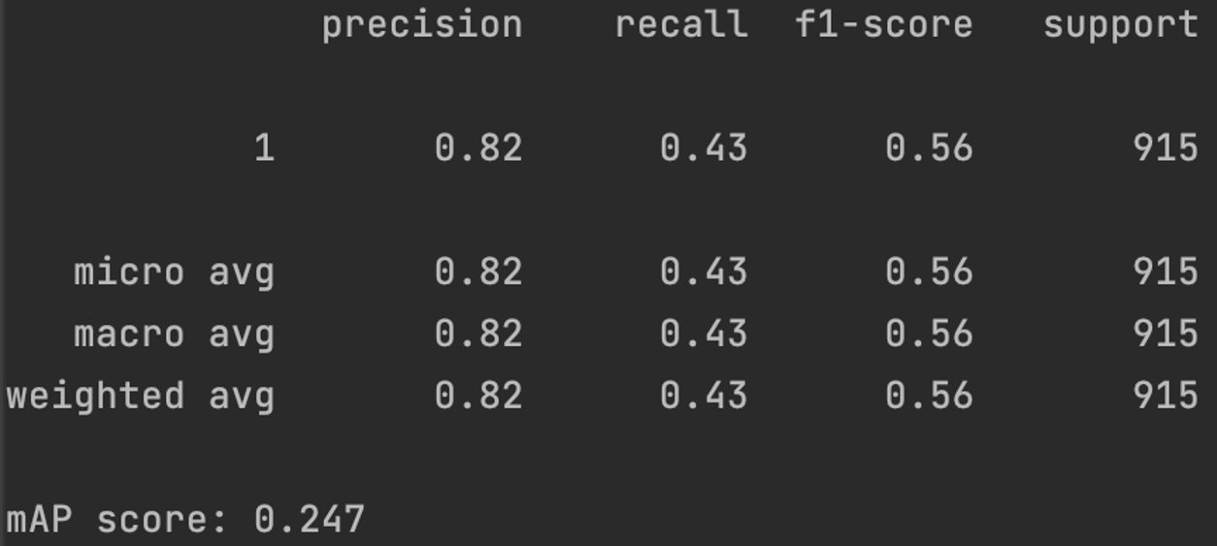
Individual Status Report- Fangji
SAHI_YOLOv8

Slide 16
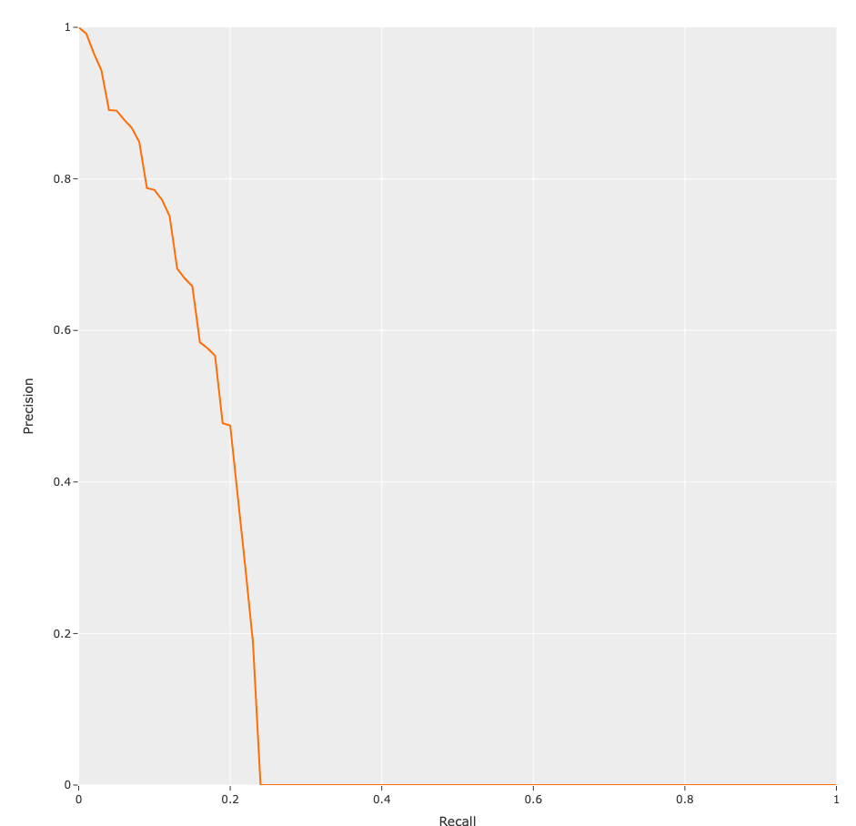
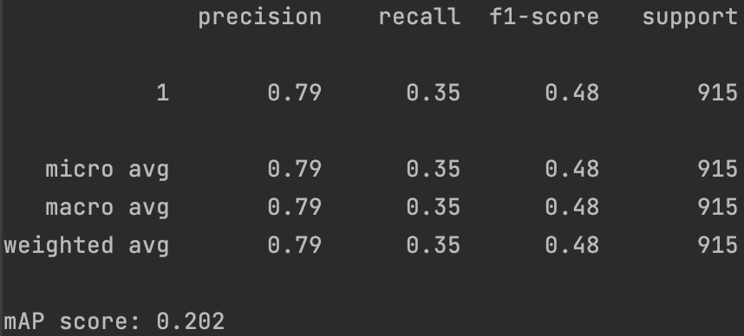
Individual Status Report- Fangji
Train_YOLOv8x_epochs53

Slide 17
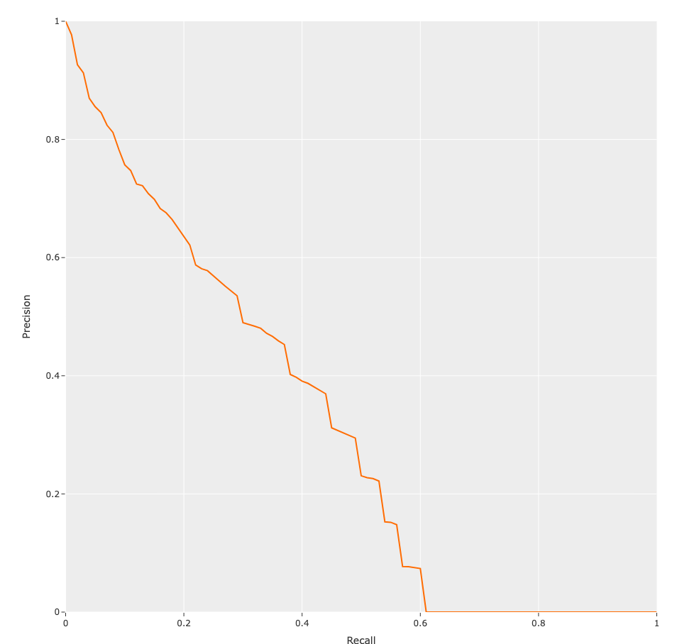
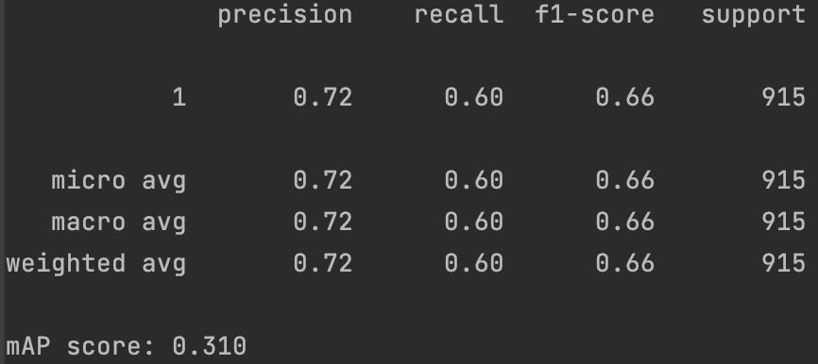
Individual Status Report- Fangji
Train_YOLOv8x_epochs53_SAHI

Slide 18
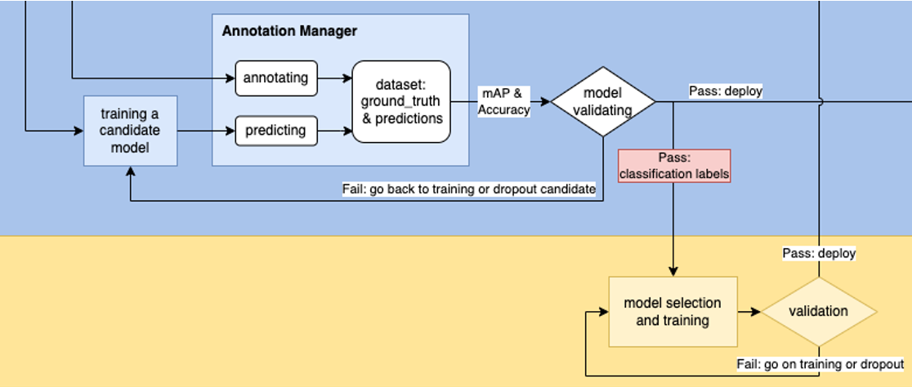
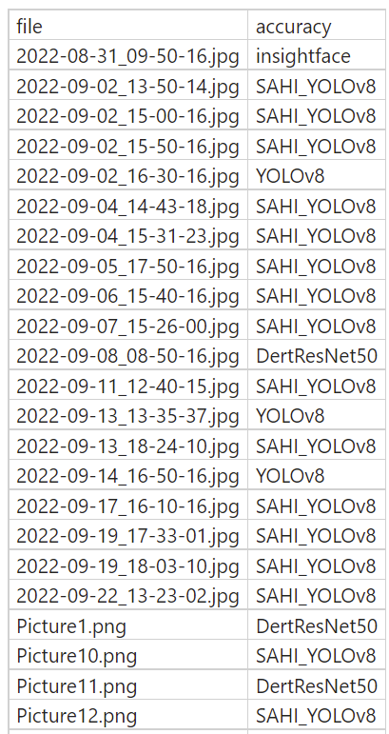
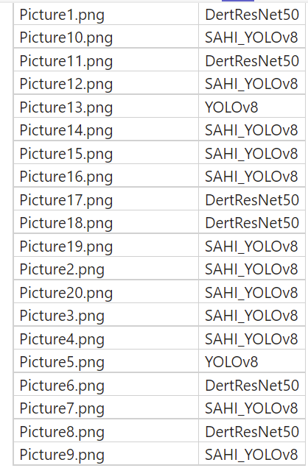
Individual Status Report- Fangji
Publish the best models for each training image as a ground truth

Slide 19
Individual Status Report- Janvi
Reverse Engineering applied.
Got accuracy matrix for crowd counting algorithm.
Which can be used for the classification algorithm.
Classification algorithm trained on the classes defined by accuracy matrix.

Slide 20
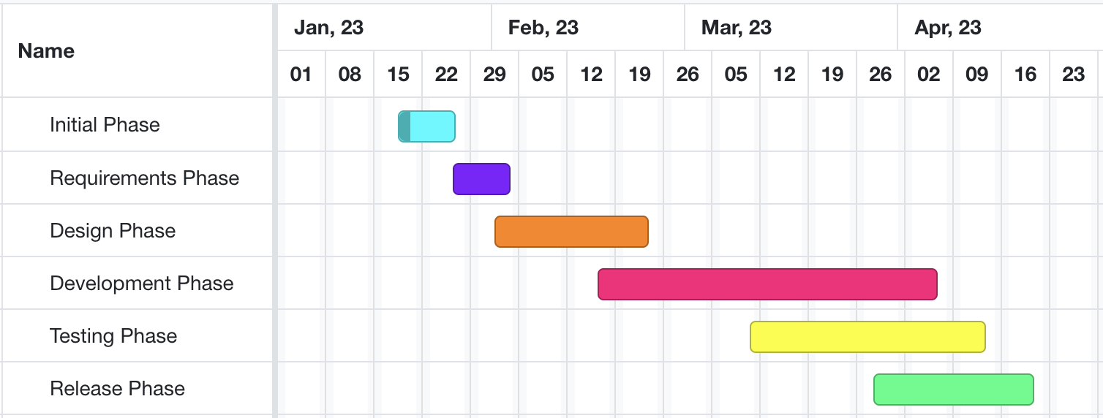
Developing and testing models on beach data
High-level GANTT Chart

Slide 21
Activities to be Completed before Next report:
Testing the models on real data.
Applying different crowd-counting models on different classes and finalizing the models for each class.
Further steps for counting the number of people in water specifically.
Final Testing of the architecture.
Notes:
Olexa, Peter (n.d.) A Person Making a Schedule. Accessed on January 18th, 2023 from https://www.pexels.com/photo/a-person-making-a-schedule-14299948/

Slide 22
Thank you!
Questions?
Notes:
Image: Leloo, The first (2022) https://www.pexels.com/photo/question-marks-on-paper-crafts-5428833/

